Slide 1


Google Machine Learning courses
Notes:
https://developers.google.com/machine-learning/crash-course

Slide 2
What you will learn
Linear Regression
Logistic Regression
Classification
Working with Numerical Data
Working with Categorical Data
Datasets, Generalization, and Overfitting
Neural Networks
Embeddings
Large Language Models
Production ML Systems
AutoML
ML Fairness

Slide 3
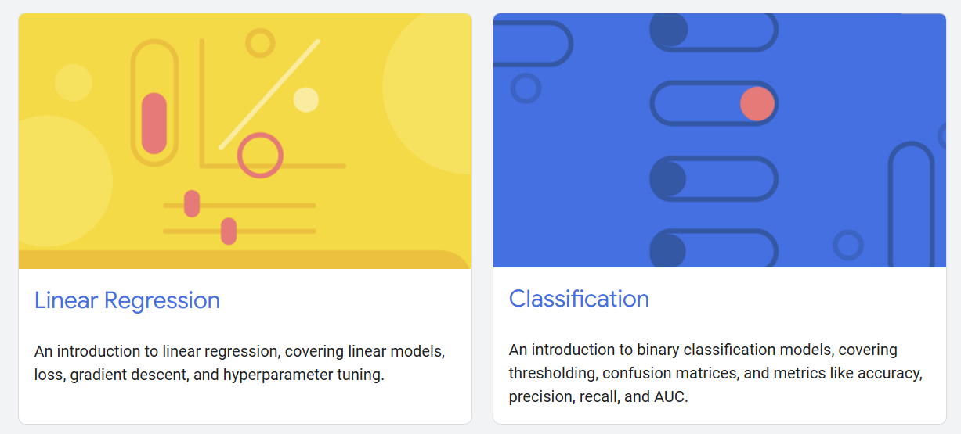

Slide 4
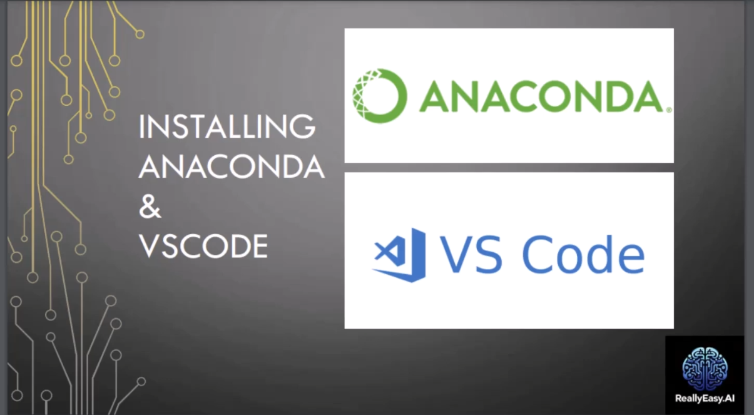
Notes:
https://www.youtube.com/watch?v=50TM9pfYv5U
https://github.com/ReallyEasyAI/Google-Machine-Learning-Courses/tree/main/03_ML_Crash_Course/artifacts

Slide 5
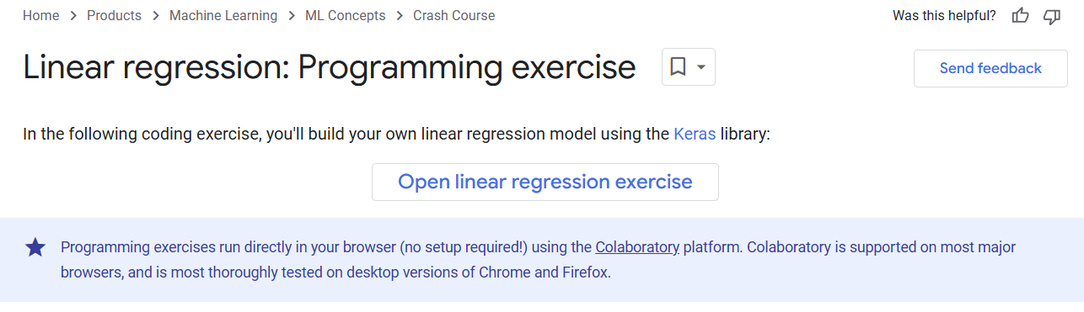
Notes:
https://developers.google.com/machine-learning/crash-course/linear-regression/programming-exercise

Slide 6
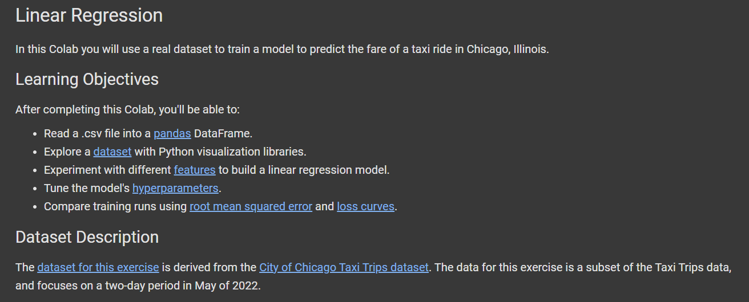
Notes:
https://colab.research.google.com/github/google/eng-edu/blob/main/ml/cc/exercises/linear_regression_taxi.ipynb

Slide 7




Notes:
https://www.youtube.com/channel/UC35ZpwldGw7ZJ5R-2sLijzw

Slide 8

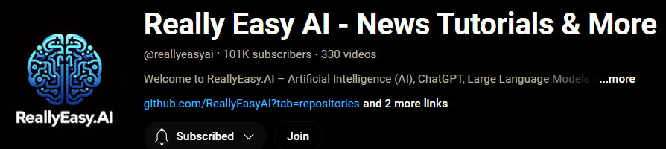
Membership has its privileges
Notes:
https://www.youtube.com/channel/UC35ZpwldGw7ZJ5R-2sLijzw/join

Slide 9

https://www.youtube.com/@AINewsFresh

Slide 10

https://www.youtube.com/@DailyAINewsPodcast

Slide 11

https://www.youtube.com/@AIPapersPodcastDaily

Slide 12
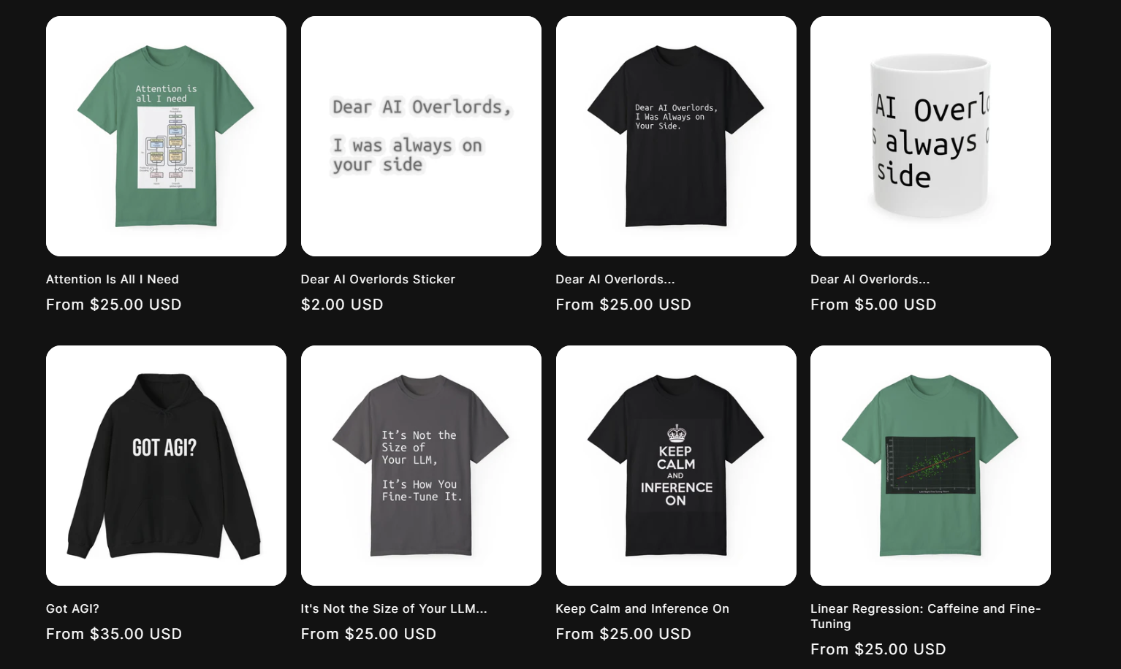
Shop.reallyeasy.ai
Notes:
https://653702-8a.myshopify.com/

Slide 13
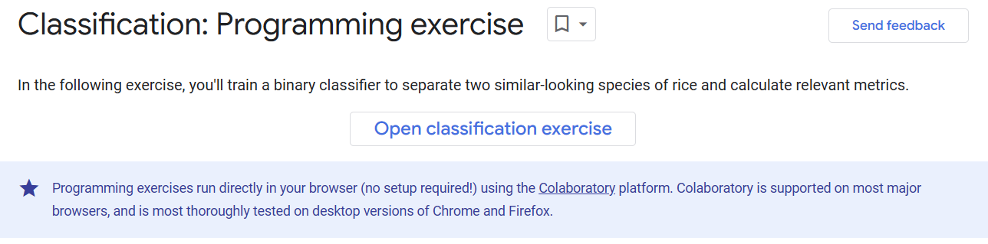
Notes:
https://developers.google.com/machine-learning/crash-course/classification/programming-exercise

Slide 14
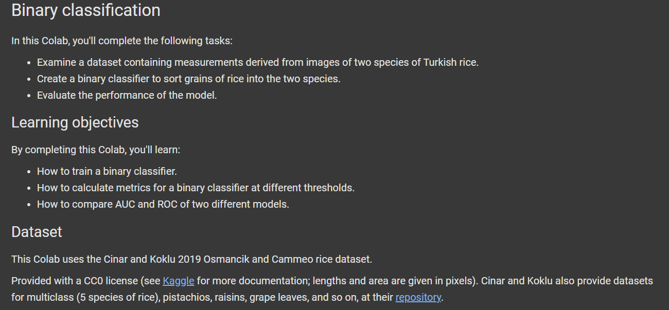
Notes:
https://colab.research.google.com/github/google/eng-edu/blob/main/ml/cc/exercises/binary_classification_rice.ipynb

Slide 15


